Slide 1
Recommendations to address constraints and bias in Integrated Data Analytics
Centering the Public Interest in Integrated Administrative Data Analytics
Module 5 of 5
Public Interest Technology University Network Year 6 Challenge
January 2026

Slide 2
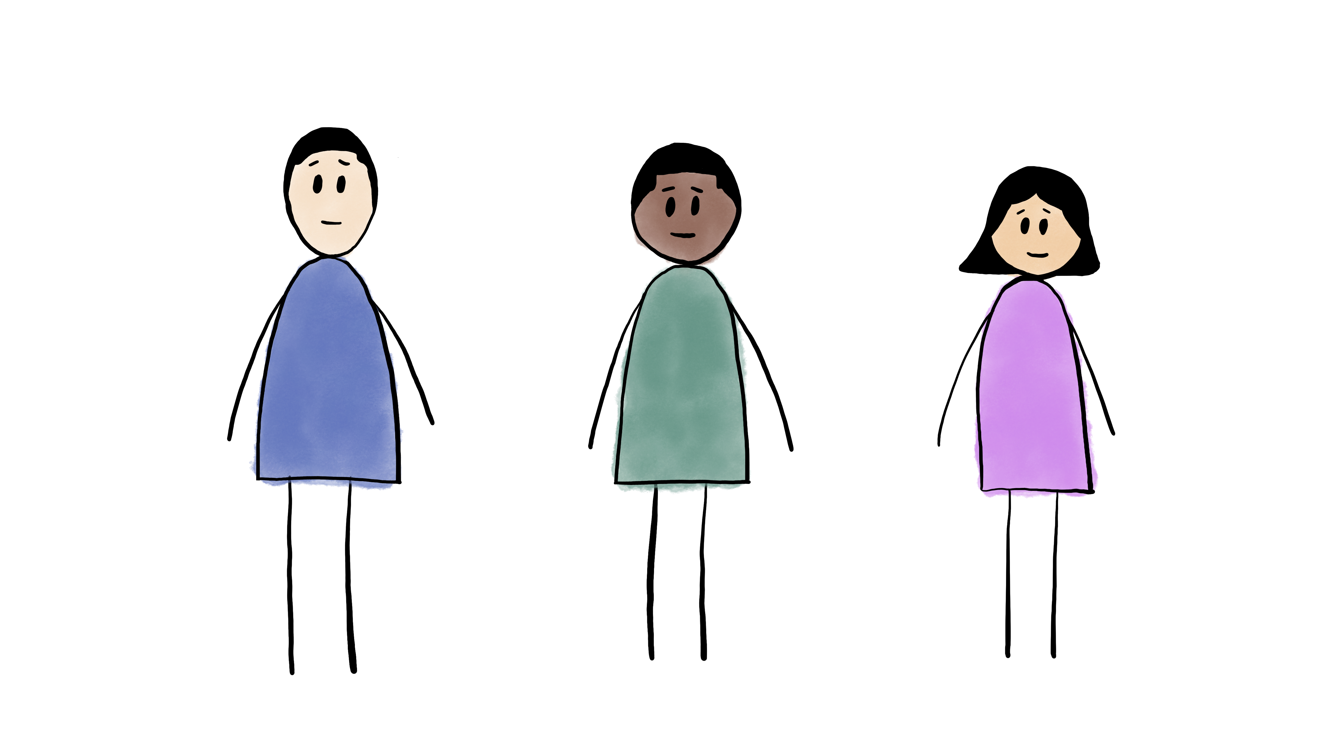
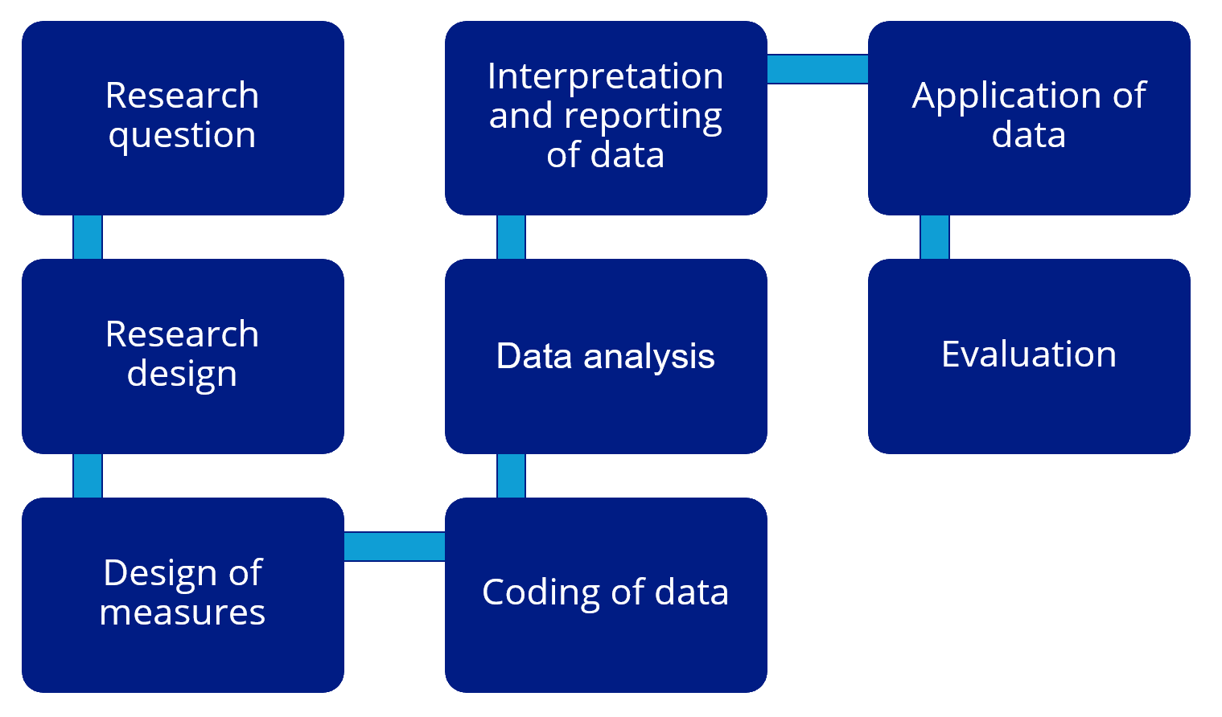


Module 3
An illustration of Label Bias in Homelessness
Data Analytics
Module 5
Recommendations to address constraints and bias in Integrated Data Analytics
2 2
Module 1
FAIR2: A framework for integrating community knowledge in data analytics and addressing discrimination bias
Module 4
An illustration of
Collider Bias in
housing research
Module 2
Demographic Data in Integrated Data Systems: Seeking Experiential Knowledge to Inform Race and Gender Data

Slide 3
Consider possible mitigation strategies at various stages
Research question
Interpretation and reporting of data
Application of data
Research design
Data analysis
Evaluation
Design of measures
Coding of data

Slide 4
Adjust the research question to be more specific and reflective of the actual data available. If we only have access to shelter data, Instead of saying:
The research question is to estimate the risk of homelessness.
Say:
The research question is to estimate the risk of shelter use.
Research question
Interpretation and reporting of data
Application of data
Research design
Data analysis
Evaluation
Design of measures
Coding of data

Slide 5
Adjust the research question to be more specific and reflective of the actual data collected Instead of saying:
The research question is how the experience of homelessness differs by gender.
Say:
The research question is how shelter use differs by gender, specifically the most recent self-reported binary gender.
Research question
Interpretation and reporting of data
Application of data
Research design
Data analysis
Evaluation
Design of measures
Coding of data

Slide 6
Use FAIR2 as a guide Frame – Articulate – Identify – Report FAIR2… Frames (meta)data with experiential knowledge, Articulates assumptions about data relationships with causal graphs, Identifies sources of bias in the data, and Reports back to those represented in the data ….leading to a more ethical use of data and analytics for the public interest.
Research question
Interpretation and reporting of data
Application of data
Research design
Data analysis
Evaluation
Design of measures
Coding of data

Slide 7
Frame and Articulate the research design: Learn about the data-generating process and metadata; make explicit your assumptions in a graphical model. Knowledge is experiential, scientific, and historical. Instead of:
Assuming data is always an accurate and objective reflection of reality,
Consider:
Under what social interactions were the data generated? Ask people represented in the data what factors might influence their data intake answers. Use a graphical model to transparently state modeling assumptions.
Research question
Interpretation and reporting of data
Application of data
Research design
Data analysis
Evaluation
Design of measures
Coding of data

Slide 8
Tap into other sources of data as needed. Instead of:
Relying solely on one data source (HMIS) to reveal homelessness.
Consider:
Indicators within other datasets that may uncover homelessness outside of shelter, such as address in food assistance data (SNAP) or school data.
Research question
Interpretation and reporting of data
Application of data
Research design
Data analysis
Evaluation
Design of measures
Coding of data

Slide 9
To increase the transparency of the data, provide data labels that are descriptive and accurate Instead of coding:
Homeless status Code:
shelter use
Research question
Interpretation and reporting of data
Application of data
Research design
Data analysis
Evaluation
Design of measures
Coding of data

Slide 10
To increase accurate representation of people's identities in the data, keep an individual's different coding of gender and race documented across data systems.
Instead of coding:
Gender = female for someone who has 5 records indicating female but 1 indicating nonbinary across 6 different timepoints (timepoints A-F) in different systems (i.e., homelessness system and food assistance system).
Code:
Gender = nonbinary at timepoint F (homelessness system)
AND
Gender = female at timepoints A-E (food assistance system)
That is, keep both identities.
Research question
Interpretation and reporting of data
Application of data
Research design
Data analysis
Evaluation
Design of measures
Coding of data

Slide 11
After Articulating modeling assumptions using experiential knowledge, Identify/screen for bias in target population, outcome and input variables. Instead of:
Only running a regression to estimate shelter- use risk that includes demographics and other variables found in HMIS data.
Consider:
Can we learn from other data (emergency room visits, food pantry data) about who is likely to experience homelessness outside of shelter? What is behind the causal pathways connecting demographic with homelessness? Stigma? Are label bias and collider bias present in your model? (reviewed in modules 3 and 4).
Research question
Interpretation and reporting of data
Application of data
Research design
Data analysis
Evaluation
Design of measures
Coding of data

Slide 12
Call attention to any known discrepancy between the target variable and the construct measured. Instead of:
Concluding “Health status is negatively related to homelessness.”
Be specific in interpretation:
“In an effort to measure the relationship between health and homelessness, we examine a proxy for homelessness, shelter use, which does not fully capture all people experiencing homelessness and may underrepresent the experiences of those who have the most significant health problems.”
Be transparent about limitations of research. Report findings to community stakeholders and seek feedback.
Research question
Interpretation and reporting of data
Application of data
Research design
Data analysis
Evaluation
Design of measures
Coding of data

Slide 13
Be mindful when applying data to practice. Instead of:
Focusing interventions only on shelter users
Find alternative ways to:
Identify and serve populations that are underrepresented in the data
Research question
Interpretation and reporting of data
Application of data
Research design
Data analysis
Evaluation
Design of measures
Coding of data

Slide 14
In every stage, remember social workers are advocates and change makers.
If a systemic barrier impacts client care, work to overcome it!
Instead of:
Feeling defeated about existing data categories in an integrated data system and powerless to change them.
Advocate:
Identify the changes that would improve client care and work to implement those changes; promote accessibility and safety as standards in service and data intake.
Research question
Interpretation and reporting of data
Application of data
Research design
Data analysis
Evaluation
Design of measures
Coding of data

Slide 15
In every stage of the research process there are opportunities to identify and address bias.
As you work through research projects, leverage interdisciplinary teams to address bias at every step of the way.
Advocate for positive social change no matter which stage or how many stages you are involved in – there is always room to advocate for a better world!
Research question
Interpretation and reporting of data
Application of data
Module 4
Module 1
Research design
Data analysis
Evaluation
Module 2
Design of measures
Coding of data
Module 3

